Slide 1
Python For Security
Revision + Basics

Slide 2
WHAT IS CYBER SECURITY?
Cyber Security is the practice of defending and protecting computer systems, mobile devices, data, networks, and servers from disruptive malicious attacks.
It also ensures protection from misdirection or disruption from the services provided by them.

Slide 3

What is Python?
Python is a powerful object-oriented programming language, and it is:
• Cross-platform
• Free
• Interpreted: it runs directly from the source code (no need to compile it)
• Often used in scripting roles
• Easily usable in conjunction with components written in other languages

Slide 4

Why Python?
Python is friendly.
Prototyping in Python is quick.
Many security tools are written in Python
Adding modules is painless.
  Widely used (Google, NASA, Yahoo, etc)
It is a multi-platform and open source language.
It is a simple, fast, robust, and powerful language.
Python allows penetration testers and programmers to save time by creating scripts that accelerate a job or task performance.

Slide 5
Python is commonly used for:
Binary analysis
Forensics
Malware analysis
Network analysis
Exploring file formats
Vulnerability and exploit analysis

Slide 6
Binary Analysis - Tasks
Disassembling code
Binary to Assembly
Automating the analysis of code
Deobfuscating code
Full binary analysis frameworks have been written in Python

Slide 7
Forensics - Tasks
File and disk analysis.
Timelines
Parsing the registry.
Memory analysis.
Analyzing memory dumps

Slide 8
Malware Analysis- Tasks
Automating the analysis of samples in a sandbox environment.
Deobfuscation, decompressing and decoding data.
Debugging and disassembling.
Scanning files.
Extracting data.

Slide 9
Network Analysis- Tasks
Protocol and decoding analysis
Network and browser emulation.
PCAP parsing.
Packet creation, sniffing and manipulation.
Custom passive DNS tool.
Automating URL lookups

Slide 10
Exploring File Formats- Tasks
Carving out embedded files in a data streams.
Exploring structured data.
Decompressing files.
Writing binary parsers
Analyzing and extracting firmware.

Slide 11
Vulnerability & Exploit Analysis Task
Fuzzing
Providing invalid, unexpected or random data as input to see if the data invokes exceptions or crashes
Scripts.
Enumerating file and network input and output
Analyzing data flow and allocation of variables

Slide 12
Working In Python

Slide 13
The print Statement
Elements separated by commas print with a space between them
A comma at the end of the statement (print (‘hello’),) will not print a newline character
print(‘hello’, ‘there’)

Slide 14
Documentation
The ‘#’ starts a line comment
>>> 'this will print'
'this will print'
>>> #'this will not'
>>>

Slide 15
String Formatting
<formatted string> % <elements to insert>
Can usually just use %s for everything, it will convert the object to its String representation.
%s :is assigned to strings
%d :is assigned to numbers
>>> "One, %d, three" % 2
'One, 2, three'
>>> "%d, two, %s" % (1,3)
'1, two, 3'
>>> "%s two %s" % (1, 'three')
'1 two three'
>>>

Slide 16
Variables & Types
Variables are simply reserved memory locations to store values. points to data stored in a memory location.
There are many types of variables, such as integers, real numbers, Booleans, strings, tuples or more complex data such as lists or dictionaries. .
Create a variable named ‘x’ and assigns the value 10 to that variable. The second statement creates a new variable y and assigns the string “Hello”.
We do not need to declare the type of the variable.
x = 10
y = “Hello”

Slide 17
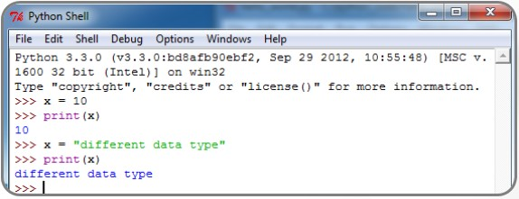
Variables & Types
The same variable could first refer to an integer value, and later be assigned a different data type.
Note that new assignments override any previous assignment.
Notes:
As shown in the above code,

Slide 18
Variables & Types
Numbers
>>> num1=22
>>> num2=33.5
>>> sum= num1+num2
>>> print("Sum of two numbers is %s"%sum)
Sum of two numbers is 55.5
>>>

Slide 19
Variables & Types
String types
Strings are a sequence of characters, sentences, or words.
>>> my_first="Welcome to python strings ! "
>>> my_first
'Welcome to python strings ! '
>>>
  String Concatenation
  >>> userName = “Mousa”
  >>> domainName = “philadelphia.edu.jo”
  >>> userEmail = userName + “@” + domainName
  >>> userEmail
  ' Mousa @ philadelphia.edu.jo‘

Slide 20
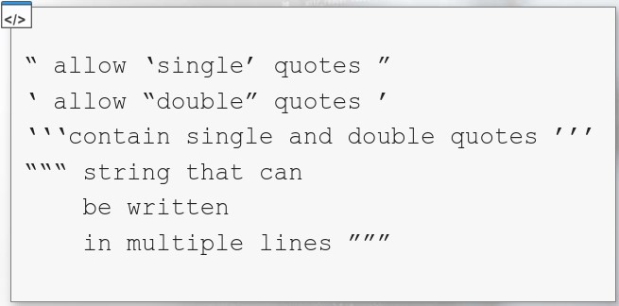
Variables & Types
Strings can be declared in many different ways.
You can use double quotes (“ string ”),
single quotes (‘ string ’),
triple single quotes (‘‘‘ string ’’’)
triple double quotes (“““ string ”””).

Slide 21
Python Operators
Arithmetic
Operator
= | Assignment
+ | Addition
- | Subtraction
* | Multiplication
/ | Division (results in float)
// | Division (results in truncation)
** | Exponentiation
% | Modulus
Functions | Example
Assignment | a=5
Addition | a + b
Subtraction | a - b
Multiplication | a * b
Division | a / b
Floor Division | a // b
Exponentiation | a ** b
Modulo | a % b

Slide 22
Python Operators
Assignment:
Functions
a = 0 a +=1 a -= 1 a *= 2 a /= 5 a **= 3 a //= 2 a %= 5 | evaluates to a=0 evaluates to a = a + 1 evaluates to a = a + 1 evaluates to a = a * 2 evaluates to a = a / 5 evaluates to a = a ** 3 evaluates to a= a // 2 (floor division 2) evaluates to a= a % 5

Slide 23
Input
The raw_input(string) method returns a line of user input as a string
The parameter is used as a prompt
The string can be converted by using the conversion methods int(string), float(string), etc.
print "What's your name?"
name = raw_input("> ")
print "What year were you born?"
birthyear = int(raw_input("> "))
print "Hi %s! You are %d years old!" % (name, 2022 - birthyear)
~: python input.py
What's your name?
>Michael
What year were you born?
>1990
Hi Michael! You are 32 years old!

Slide 24
Logical operators:
Operator
< | Less than
<= | Less than or equal
== | Equal
> | Greater than
>= | Greater than or equal
!= | Not equal
And | Logical AND
Or | Logical OR
Not | Logical NOT
The following table summarizes the comparison and logical operators that return True or False.

Slide 25

Logical operators:
And: True: If both the operands are true, then the condition becomes true. For example, (a and b) is true.
Or: True: If any of the two operands are non-zero, then the condition becomes true. For example, (a or b) is true.
Not: True: This is used to reverse the logical state of its operand.
For example, not (a and b) is false.
Functions | Example
and | a & b
or | a | b
xor | a ^ b

Slide 26
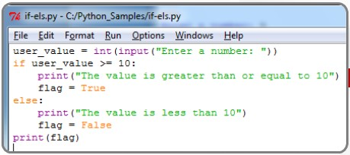
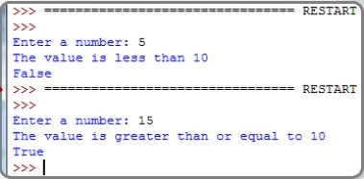
Logical operators:

Slide 27
Conditional statements
The conditional statements supported by Python are as follows:
if condition
if...else condition
else...if conditional ladder, known as elif in Python

Slide 28
The if condition
The if condition or the if statement takes a statement and returns either a Boolean True or a Boolean False value after evaluating the statement.
if <condition> : and then indented code
If the condition returns True, the code proceeding the if statement (equally indented) is executed.
If the statement/condition evaluates to False, then either the else block of code gets executed if there is one, or the block of code following the if block is executed, so the if block is effectively skipped.
a=44
b=33
if a > b:
print("a is greater")
print("End")

Slide 29
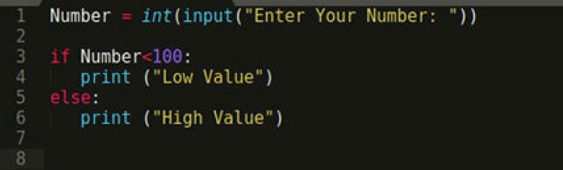
The if...else condition
The if...else condition is pretty much the same as in any other language.
If the if condition evaluates to a True value, the code block indented under if is executed. Otherwise, the code block indented under the else block is executed.
Where a statement may consist of a single statement, a block of statements, or nothing (in the case of an empty statement).
a=44
b=66
if a > b:
print("a is Greater")
print(“I love Python")
else:
print("B is either Greater or Equal")
print("End")

Slide 30
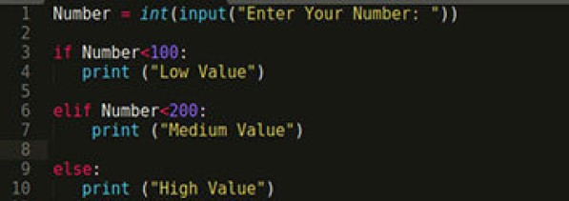
The if...elif condition
The if...elif ladder, popularly known as if...else if in other programming languages such as C, C ++, and Java, has the same function in Python.
An if condition let's specify a condition alongside the else part of the code. Only if the condition is true is the section proceeding the conditional statement executed.
a=44
b=66
if a > b:
print("a is Greater")
elif b > a:
print("B is either Greater or Equal")
else:
print("A and B are equal")
print("End")

Slide 31
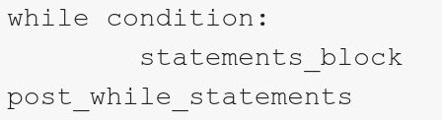
Loops
Python offers two loops:
while loop
for loop
As long as the condition is evaluated to True, the body of the while (statement_block) is executed repeatedly.
When the condition is evaluated to False, the while loop terminates, and the post_while_statementswill be executed.

Slide 32
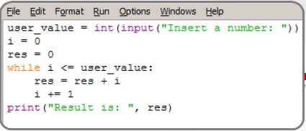
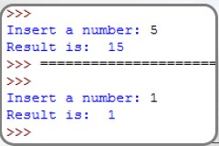
Loops
while loop
5 => 5+4+3+2+1+0 => 15
1 => 1+0 => 1

Slide 33
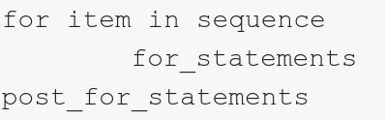
Loops
For loop
Another loop statement is the for loop. Its general form is:
Unlike many other programming languages, in Python, the for loop does not increment and test a variable against a condition on each iteration.

Slide 34
Loop Control Statements
break | Jumps out of the closest enclosing loop
continue | Jumps to the top of the closest enclosing loop
pass | Does nothing, empty statement placeholder

Slide 35
The Loop Else Clause
The optional else clause runs only if the loop exits normally (not by break)
x = 1
while x < 3 :
print x
x = x + 1
else:
print 'hello'
~: python whileelse.py
1
2
hello

Slide 36
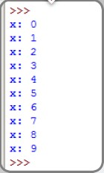
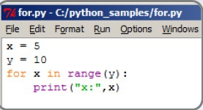
Loops
for loop
in the first loop, x is set to be the first item in the sequence;
in the second loop, it is set to be the second item of the sequence,
and so on (no matter what was its value before the loop).

Slide 37
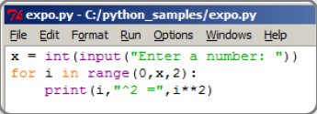
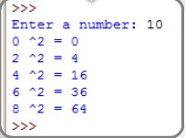
Loops
To write a program that calculates the exponential value (^2) of all the even numbers in the range from 0 to a given number.

Slide 38
The Loop Else Clause
For loops also may have the optional else clause
for x in range(5):
print x
break
else :
print 'i got here'
~: python elseforloop.py
1

Slide 39

Lists
Python lists are similar to arrays in other programming languages; they are ordered collections of any type of object.
Lists are data structures that hold values separated by commas inside square brackets ([]) These values can either be strings or integers.

Slide 40
Lists
In almost every programming language, indices start from 0; this applies to Python as well.
Index | Element value
0 | first
1 | 2
2 | els
3 | 4

Slide 41
Lists
lists can contain objects of different types.
We do not need to fix its size.
Python gives you the ability to append values at the end of the list.
You can also remove a value from the list.
>>> example = ['python', 'is', 'number', 1]
>>> print (example)
['python', 'is', 'number', 1]

Slide 42
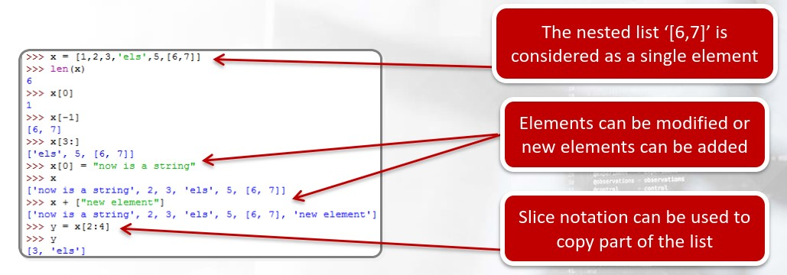
Nested Lists

Slide 43
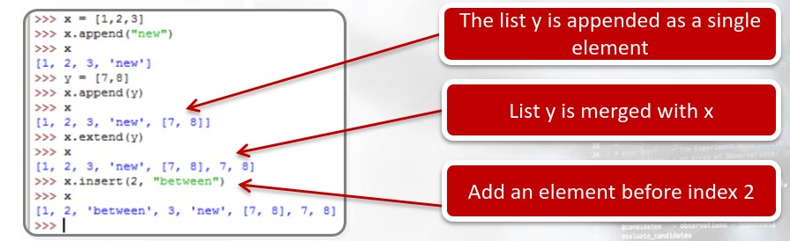
Lists
Python implements many functions that can be used to modify a list:
• append: append a new element to the target list
• extend: allows to add one list to another
• insert: add a new list element right before a specific index

Slide 44
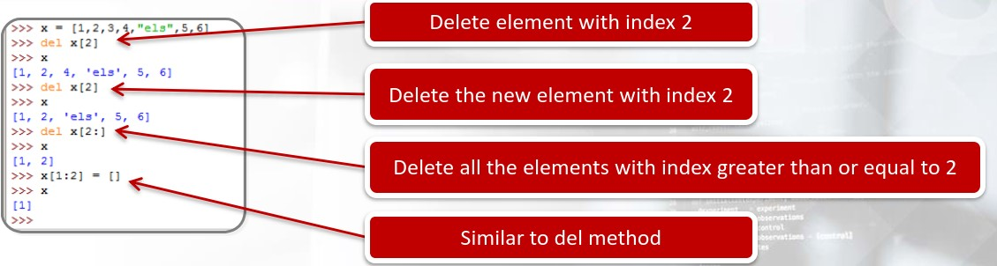
Lists
While the previous methods can be used to add or edit list elements, the del method can be used to delete list items.
Note that once elements are deleted, indices are automatically updated.

Slide 45
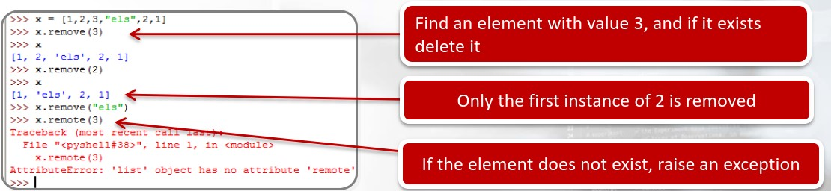
Lists
The remove method is quite different from the others. It does not work with indices; instead, it looks for a given value within the list, and if this exists, it removes the element.
Note that only the first instance of that value is removed.

Slide 46
Dictionaries
The general form of a dictionary consists of one or more “key:value” pairs embraced in curly brackets:
Where the element on the left of the of the colon is the key, and the element on the right is its associated value.
As much as lists, dictionaries can store objects of any type and values are not implicitly ordered.

Slide 47
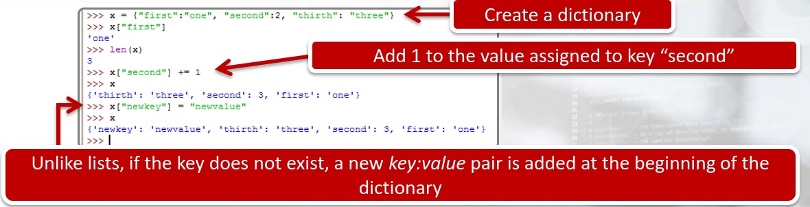
Dictionaries
The above code shows some operations on dictionary elements.
we can access an element like we did with lists, but now we have to use keys instead of indices.

Slide 48

Functions
A function is a group of statements that gets executed when it is called (function call).
The general form of a function definition is:
Where:
def indicates a function definition.
function_name is the identifier of the function.
parameters is a comma-separated list of variables.
function_statements is the body of the function.
return exits a function and gives the execution back to the caller.

Slide 49
Functions
Can be assigned to a variable
Can be passed as a parameter
Can be returned from a function
Functions are treated like any other variable in Python, the def statement simply assigns a function to a variable

Slide 50
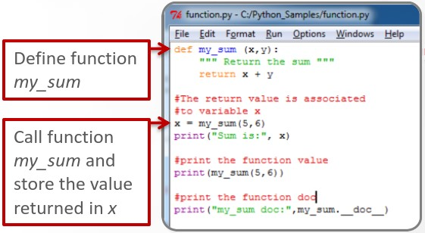
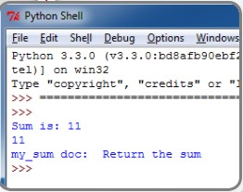
Functions
The program shows how to define a function that returns the sum of two numbers.
Note that every function should be documented.

Slide 51
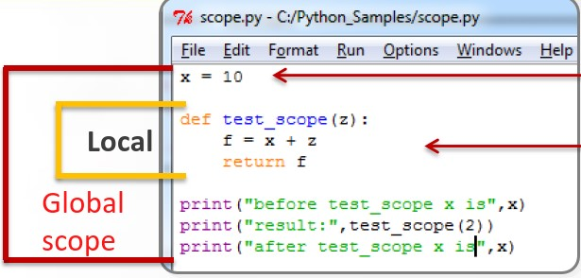

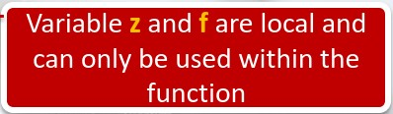
Functions
One of the most important things when using functions is to understand the scope of variables.
In Python, each call to a function creates a new local scope as well as all the assigned names within a function that are local to that function.

Slide 52
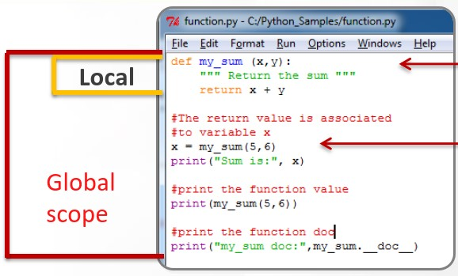
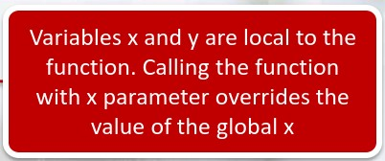

Functions
The variable scope
Two variables x are used, but they have different values depending on their scope.
The first x is local to the function and can be used only within my_sum. Each change made to this variable has no effect outside the function.
The second x is global and can be used in the entire program (within the single file).

Slide 53
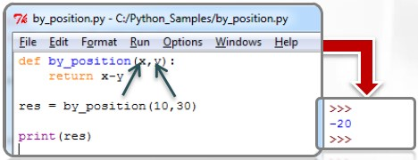
Functions
Parameters are usually passed by position; this means that when we call a function, the parameters in the calling function are matched according to their order.
So the number of parameters used by the caller and the called function must be the same; otherwise, an exception will be raised.

Slide 54
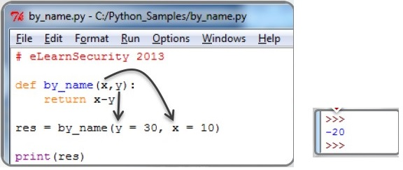
Functions
In Python, we can change this behavior passing variables by name; this is possible by using the name of the corresponding parameter.

Slide 55

Modules
A module is a file that contains source code. The main purpose of modules is to group Python functions and objects in order to organize larger projects. Note that in addition to Python code, we can also import C++ object files.
To import any function or any object within the module, we can use the following syntax:
Moreover, if we want to import all functions and objects within the module, we can also use the following syntax:

Slide 56
Modules
  The most commonly used modules with security coding are:
  string, re
  os, sys, socket
  hashlib
  httplib, urllib2

Slide 57
The OS Module
Python OS module provides the facility to establish the interaction between the user and the operating system.
It offers many useful OS functions that are used to perform OS-based tasks and get related information about operating system.
The OS comes under Python's standard utility modules. This module offers a portable way of using operating system dependent functionality.
To work with the OS module, we need to import the OS module.
import os

Slide 58
The OS Module
Running external programs are very essential in most programming languages, especially the scripting.
>>> Import os
>>> print os.system("notepad.exe")
Getting Current Working Directory
The os.getcwd() function confirms returns the current working directory.
>>> import os
>>> os.getcwd()
'C:\\Python27'
>>>

Slide 59
The OS Module
The os.mkdir() function is used to create new directory.
It will create the new directory to the path in the string argument of the function in the D drive named folder philadelphia.
>>> os.mkdir("d:\\ philadelphia")
>>>
The rmdir() function removes the specified directory with an absolute or related path.
>>> os.rmdir("d:\\ philadelphia")
>>>

Slide 60
The OS Module
The os.name : gives the name of the OS module it imports. This differs based on the underlying Operating System. Currently, it registers ‘posix’, ‘os2’, ‘ce’, ‘nt’, ‘riscos’ and ‘java’.
We run it on Windows 7: Windows 7 is also known as Windows NT 6.1
>>> import os
>>> os.name
'nt'

Slide 61
The OS Module
The os.startfile() method allows us to “start” a file with its associated program.
In other words, we can open a file with it’s associated program, just like when you double-click a PDF and it opens in Adobe Reader.
>>> os.startfile('D:\py1.pdf')
>>>

Slide 62
The sys Module
The sys module provides system specific parameters and functions.
To work with the SYS module, we need to import the SYS module.
import sys
The sys.platform value is a platform identifier.
>>> import sys
>>> sys.platform
'win32'
>>>

Slide 63
The sys Module
The sys.exit() function allows to exit from Python.
The exit function takes an optional argument, typically an integer, that gives an exit status.
Zero is considered a “successful termination”.
>>> import sys
>>> print(“I am student”)
>>> sys.exit(0)

Slide 64
The sys Module
The sys.path is a list of strings that specifies the search path for modules.
Basically this tells Python what locations to look in when it tries to import a module.
>>> import sys
>>> print(sys.path)
['', 'C:\\Python27\\python27.zip', 'C:\\Python27\\DLLs', 'C:\\Python27\\lib', 'C:\\Python27\\lib\\plat-win', 'C:\\Python27\\lib\\lib-tk', 'C:\\Python27', 'C:\\Python27\\lib\\site-packages’]
>>>

Slide 65
The hashlib Module
The hashlib module is an interface for hashing messages easily. This contains numerous methods which will handle hashing any raw message in an encrypted format.
The core purpose of this module is to use a hash function on a string, and encrypt it so that it is very difficult to decrypt it.

Slide 66
The hashlib Module
To work with the hashlib module, we need to import the hashlib module.
import hashlib
Available Hashing Algorithms:
The algorithms_available attribute prints every algorithm used in the system, which includes other programs such as ssh and OpenSSL.
2. The algorithms_guaranteed attribute lists all the algorithms in the module.

Slide 67
The hashlib Module
Algorithms Available:
>>> import hashlib
>>> print(hashlib.algorithms_available)
set(['SHA1', 'SHA224', 'SHA', 'SHA384', 'ecdsa-with-SHA1', 'SHA256', 'SHA512', 'md4', 'md5', 'sha1', 'dsaWithSHA', 'DSA-SHA', 'sha224', 'dsaEncryption', 'DSA', 'RIPEMD160', 'sha', 'MD5', 'MD4', 'sha384', 'sha256', 'sha512', 'ripemd160', 'whirlpool’])
Algorithms Guaranteed:
>>> import hashlib
>>> print(hashlib.algorithms_guaranteed)
set(['sha1', 'sha224', 'sha384', 'sha256', 'sha512', 'md5'])

Slide 68
The hashlib Module
Two way to create the hashlib function :
hashlib.md5(password)
2. hashlib.new('md5',password)
>>> import hashlib
>>> password = '18779385769wl'.encode()
>>> result2 = hashlib.md5(password)
>>> print(result2)
<md5 HASH object @ 0301B878>
>>>
>>> import hashlib
>>> password = '18779385769wl'.encode()
>>> result1 = hashlib.new('md5',password)
>>> print(result1)
<md5 HASH object @ 0301B230>
>>>

Slide 69
The hashlib Module
hash.digest()
  Return the digest of the data passed to the update() method. This is a bytes object of size digest_size which may contain bytes in the whole range from 0 to 255.
>>> import hashlib
>>> sha1 = hashlib.sha1()
>>> data = "this is the first security python program"
>>> sha1.update(data.encode("utf-8"))
>>> print(sha1.hexdigest())
91b36a3546057e1778605847eac2b216fae7f432
>>> print(sha1.digest())
ّ│j5F~x`XGم┬▓·قَ2
>>> print(sha1)
<sha1 HASH object @ 0301B398>
>>>
  hash.hexdigest()
  Like digest() except the digest is returned as a string object of double length, containing only hexadecimal digits. This may be used to exchange the value safely in email or other non-binary environments.

Slide 70
Reading and Writing Files
in Python, a file operation takes place in the following order:
Open a file
Read or write
Close the file
Mode | Description
'r' | Open for text file for reading text
'w' | Open a text file for writing text
'a' | Open a text file for appending text

Slide 71
Reading and Writing Files
Opening Files in Python
Python has a built-in open() function to open a file. This function returns a file object, also called a handle, as it is used to read or modify the file accordingly.
>>> f = open("test.txt“, “r”) # open file in current directory
>>> f = open("C:\PythonForSecurity\test1.txt“,”w”) # specifying full path

Slide 72
Reading and Writing Files
Closing Files in Python
When we are done with performing operations on the file, we need to properly close the file.
It is done using the close() method available in Python.
>>>f = open("test.txt“, “r”)
# perform file operations
>>>f.close()

Slide 73
Reading and Writing Files
Writing to Files in Python
In order to write into a file in Python, we need to open it in write ”w” , or “a” append mode.
We need to be careful with the w mode, as it will overwrite into the file if it already exists. Due to this, all the previous data are erased.
>>> f = open("D:\Test\First.txt","w")
>>> f.write("my first file\n")
>>> f.write(“This file\n\n")
>>> f.write(“contains three lines file\n")
>>>f.close()

Slide 74
Reading and Writing Files
The file object provides three methods for reading text from a text file:
read() : read all text from a file into a string.
readline() : read the text file line by line and return all the lines as strings.
readlines() : read all the lines of the text file and return them as a list of strings
read all texts from the file.txt file into a string
>>> f = open("D:\Test\First.txt","r")
>>> f.readlines()
['my first file\n', 'my first file22222\n', 'my first file55555']
>>>f.close()
>>>

Slide 75
Reading and Writing Files
Appended line
Sometimes, we often append new content to an existing file at the end of the file .
we can use the append mode (a).
>>> f = open("D:\Test\First.txt","a")
>>> f.write(“\npython for security is very importan\n")
>>> f.close()
>>> f = open("D:\Test\First.txt","r")
>>> f.readlines()
['my first file\n', 'my first file22222\n', 'my first file55555\n’,’python for security is very importan\n’]
>>>f.close()
>>>

